Slide 1
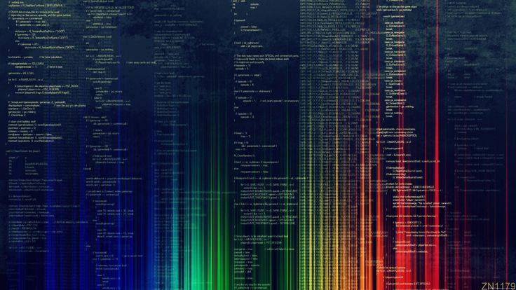
Lab 1: Introduction to Python Programming
Adapted from
Bio5488 Genomics 2022 TAs

Slide 2
Overview
Logistics
Getting Started
Intro to Unix
Intro to Python
Assignment 1

Slide 3
Getting the most out of this course
Start the homework EARLY
Collaborate
Use your resources – TAs, professors, labmates, Piazza discussions,
the internet

Slide 4
Logistics
Office Hours: Friday, 10:30 am - noon (right after lab session)
Contact TAs:
For questions: Piazza
Register for 4 credits
Course website: http://genetics.wustl.edu/bio5488/
Bring your laptop to every lab
NO extensions on homeworks
Late penalty is 50% per day

Slide 5
Assignments
Assignments are assigned on Wednesdays
We will send out emails when assignments are posted
Assignments are due the following Friday night
Assignment format
Given a bioinformatics problem
Write/complete a Python script
Analyze data with your script
Answer biological questions about your results
Turn in format
More on this later ☺

Slide 6
Assignment policies
See the Course Information → Assignment policies document in the course
website
There are 13 assignments
You will drop your two lowest scores.
All assignments are weighted equally
Collaboration
Group work is encouraged, but plagiarism is unacceptable
Try to “Google it” first
Cite your sources
Read the assignment before coming to lab

Slide 7
Grading
Each assignment is out of 10 points
Graded on
Does the code work?
It doesn’t have to be the “fastest” or “most efficient” to get full credit
If doesn’t work, describe where you had problems
Is the code well commented and readable? (more on commenting later ☺)
Are the answers correct?
Grades will be returned in a file called grades.txt on the class server
Only you and the TAs will be able to read this file

Slide 8
Getting started

Slide 9
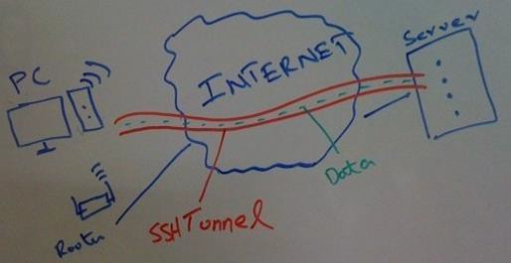
Remote computers
We will be doing all of our work on a remote computer, a server
This is a Unix-based computer that we can securely connect to through a protocol called secure shell (SSH).
The shell is a program that takes commands from the keyboard and
gives them to the operating system to execute

Slide 10
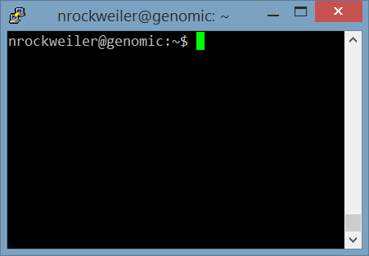
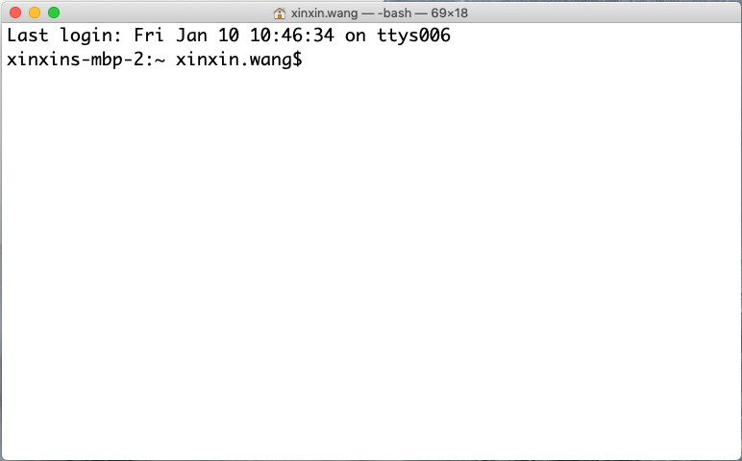
How do I access the server?
The way we are using here is
command-line interfaces (CLI)
A terminal emulator is a program that allows you to interact with the shell through a CLI
There are different terminal programs
that vary across operating systems
We’ll be using PuTTY(Windows) or
Terminal (Mac, Ubuntu)
A PuTTY window
10
A Terminal window

Slide 11
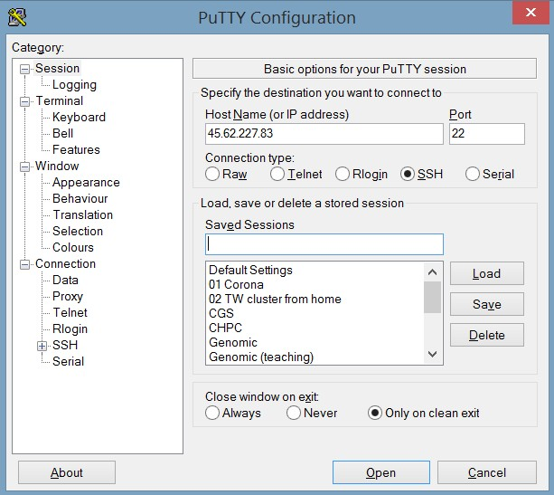
How to log onto the remote computer (PuTTY users)
Launch PuTTY
In the host name field, enter
<username>@compute1-client-1.ris.wustl.edu
In the port field, enter 22
Enter a session nickname, e.g., bio5488 (whatever name you want!)
Click Save
Click Open

Slide 12
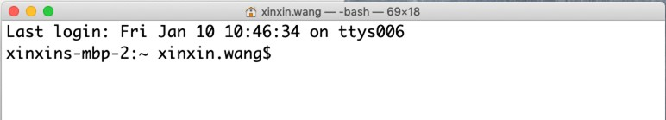
How to log onto the remote computer (Mac/Ubuntu users)
1. Open Terminal (found in /Applications/Utilities)

Slide 13
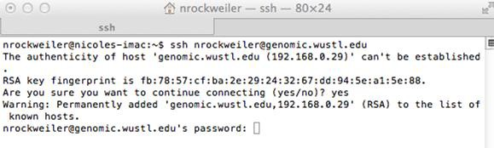


How to log onto the remote computer (Mac/Ubuntu users)
SSH to the remote computer. Type:
ssh <username>@compute1-client-1.ris.wustl.edu
where <username> is replaced with your username
A security message may be printed. Type yes and hit enter.

Slide 14
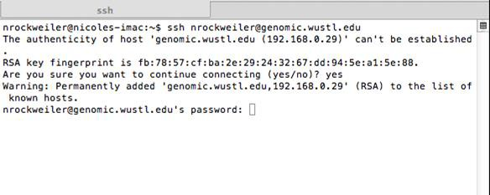
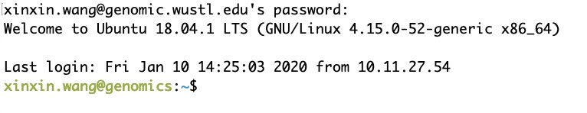
How to log onto the remote computer (Mac users)
4. Enter your password - Hit
enter.
it will not show that you are typing!

Slide 15
A couple of notes
When you log onto the class server you will be located in YOUR home directory.
Every command that you run after logging onto a remote computer will be run on that computer.

Slide 16
VS CODE
We will be using VSCode to edit local and remote files.
Download here: https://code.visualstudio.com/Download
To ssh into the server using VScode, you must install the Visual Studio Code Remote - SSH extension from the extension manager.

Slide 17

Cyberduck
Cyberduck is a secure file transfer client and will allow you to transfer files from your local computer to a remote computer

Slide 18

Exercise: setting up Cyberduck
Create a bookmark
Launch the Cyberduck application
Click Bookmark → New Bookmark
Select SFTP (SSH File Transfer Protocol) from the drop down menu
Enter a nickname for the bookmark, e.g., bio5488
Enter genomic.wustl.edu as the server name
Click the X
Set the default text editor
Click Edit → Preferences → Editor
Select sublime text from the drop down menu. (You may need browse your computer for the editor)
Check Always use this application
Restart Cyberduck

Slide 19
Exercise: transferring files with Cyberduck
To download a file to your local computer
Drag and drop a file from Cyberduck to your Finder/File Explorer window
Or, double-click
To upload a file to the remote computer
Drag and drop a file from Finder/File Explorer to Cyberduck

Slide 20
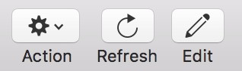
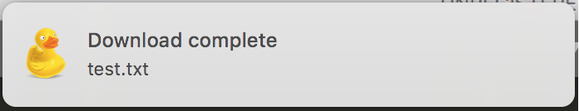
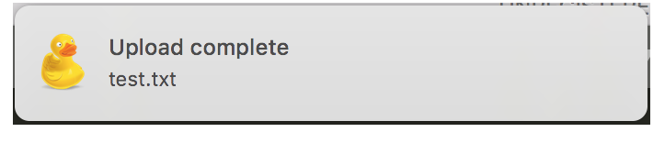
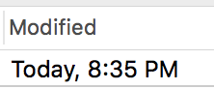
Cyberduck
Attention about using Cyberduck:
When clicking on
Make sure you see this
When saving the file, make sure you see the following to make sure the upload is complete before you close the editor
Before closing the editor, check the time stamp of file

Slide 21

FileZilla
FileZilla is an alternative approach for Cyberduck
Can be downloaded for free here: https://filezilla- project.org/

Slide 22
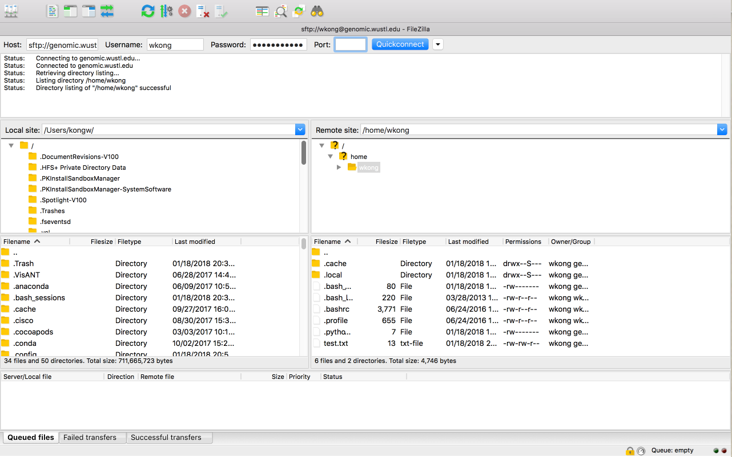
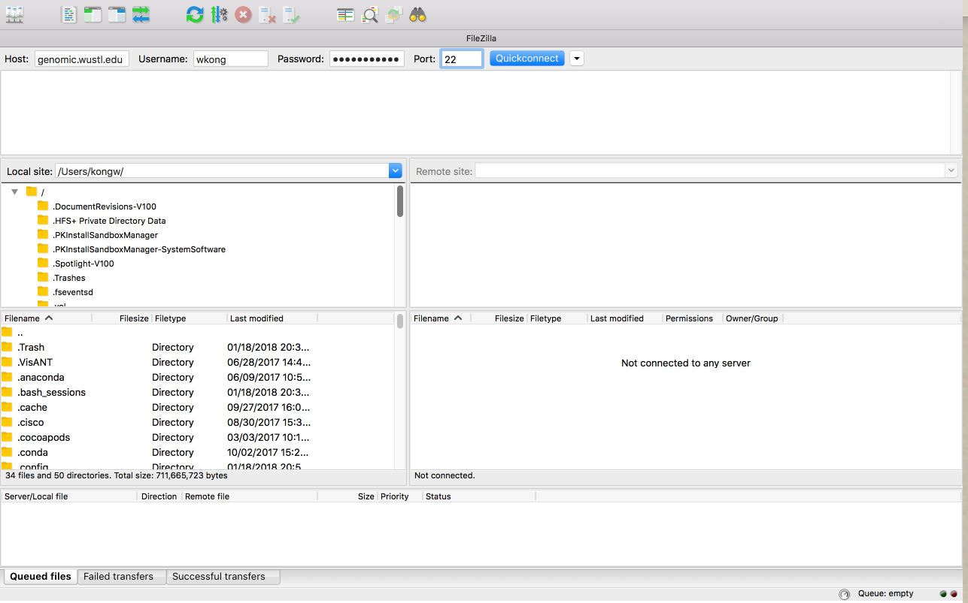
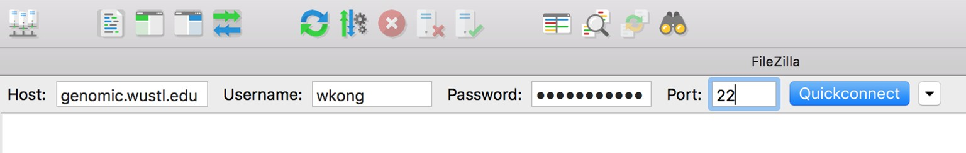
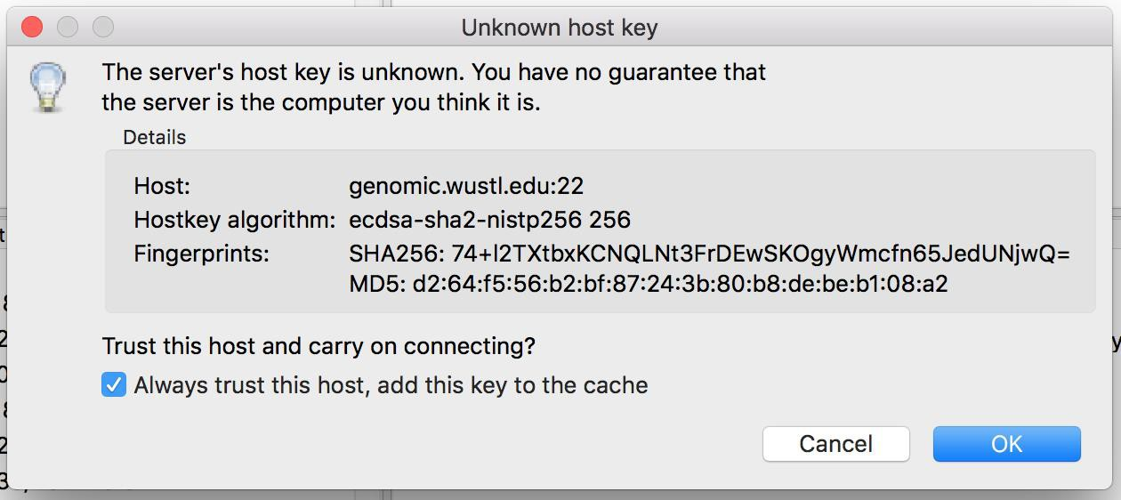
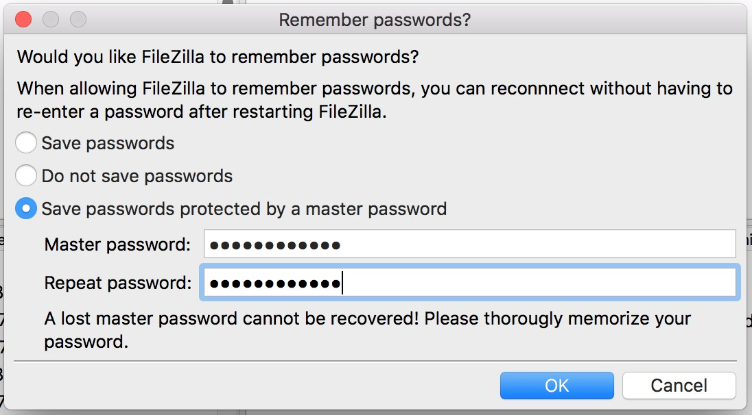
FileZilla
Follow the instructions
Finally we should see this

Slide 23
Basic Unix

Slide 24
A few preliminary words…
A lot of Unix skills revolve around the file system
This concept is similar to using Apple Finder or the
Windows File Explorer GUIs, only this time, we can’t use
a mouse or see any fancy graphics

Slide 25
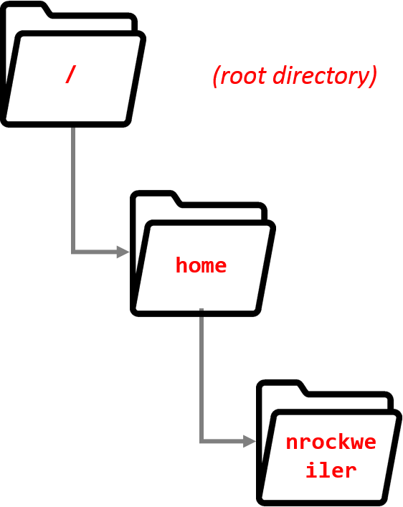
The file system
The file system is the part of the operating system (OS) responsible for managing files and folders
In Unix, folders are called directories.
Unix keeps files arranged in a hierarchical structure
The topmost directory is called the root directory
Each directory can contain
Files
Subdirectories
You will always be “in” a directory
When you open a terminal you will be in your own home
directory.
Only you can modify things in your home directory
user

Slide 26
Determining where you are (pwd)
If you get lost in the file system, you can determine where you are by typing:
$ pwd
/home/user
pwd stands for print working directory
pwd prints the full path of the current working directory

Slide 27
Listing directory contents (ls)
To list the contents of a directory:
$ ls assignment1 foo
ls stands for list directory contents

Slide 28

Changing directories (cd)
To change to different directory
$ cd <directory_name>
where
<directory_name> = the path you want to move to
A path is a location in the file system
cd stands for change directory
To get back to your home directory
$ cd ~
~ is shorthand for your home directory

Slide 29
Changing directories (cont.)
To move one directory above the current directory
$ cd ..
To move two directories above the current directory
$ cd ../../
You can string as many ../ as you need to
user

Slide 30

Making directories (mkdir)
To make a directory
$ mkdir <new_directory_name>
where
<new_directory_name> = name of the directory to create
mkdir stands for make directory
Do not use spaces or “/” in directory or file names

Slide 31
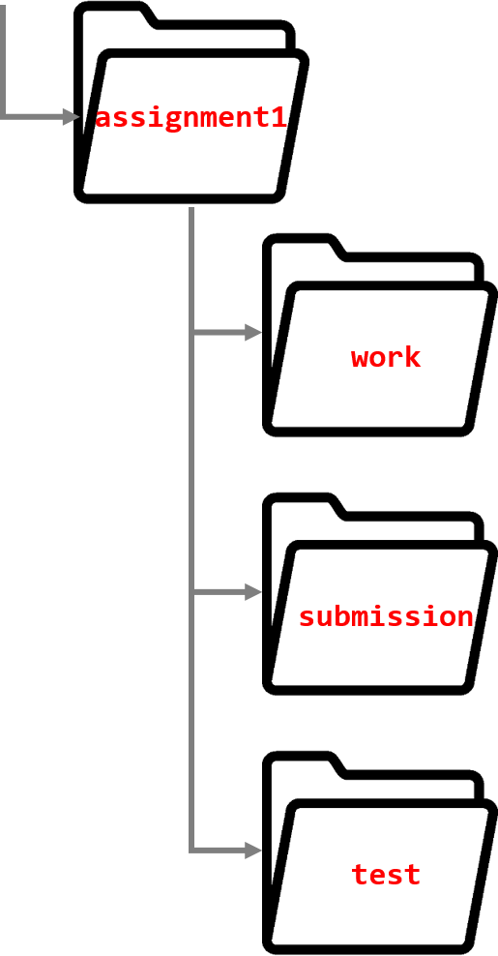
Exercise: create some directories
Try to create this directory structure:
Hints
Use pwd to determine where you are in the directory structure
Use cd to navigate through the directory structure.
Use mkdir to create new directories

Slide 32
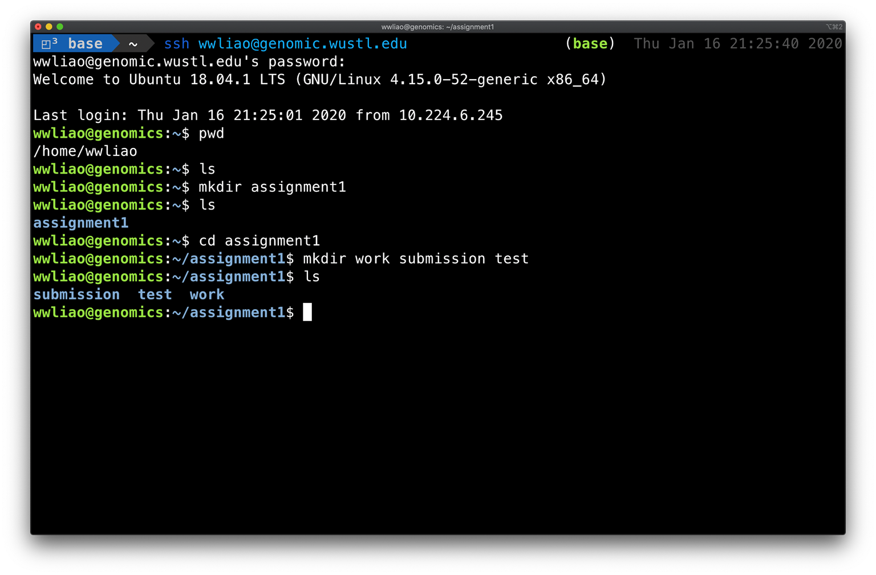

Slide 33
Copying things (cp)
To create a copy of a file
$ cp –i <filename> <copy_of_filename>
where
<filename> = file you want to copy
<copy_of_filename> = name of copied file
The -i flag is a safety feature to make sure you do not overwrite a file that already exists
To create a copy of a directory
$ cp -r <directory> <copy_of_directory>
where
<directory> = directory you want to copy
<copy_of_directory> = name of copied directory
The -r flag is required to copy all of the directory’s files and subdirectories
35

Slide 34
Copying things (cont.) (cp)
cp stands for copy files/directories
To create a copy of file and keep the name the same
$ cp –i <filename> .
where
<filename> = file you want to copy
The shortcut is the same for directories, just remember to include the -r flag

Slide 35
Exercise: copying things
Copy /home/assignments/assignment1/README.txt to your work directory. Keep the name the same.

Slide 36
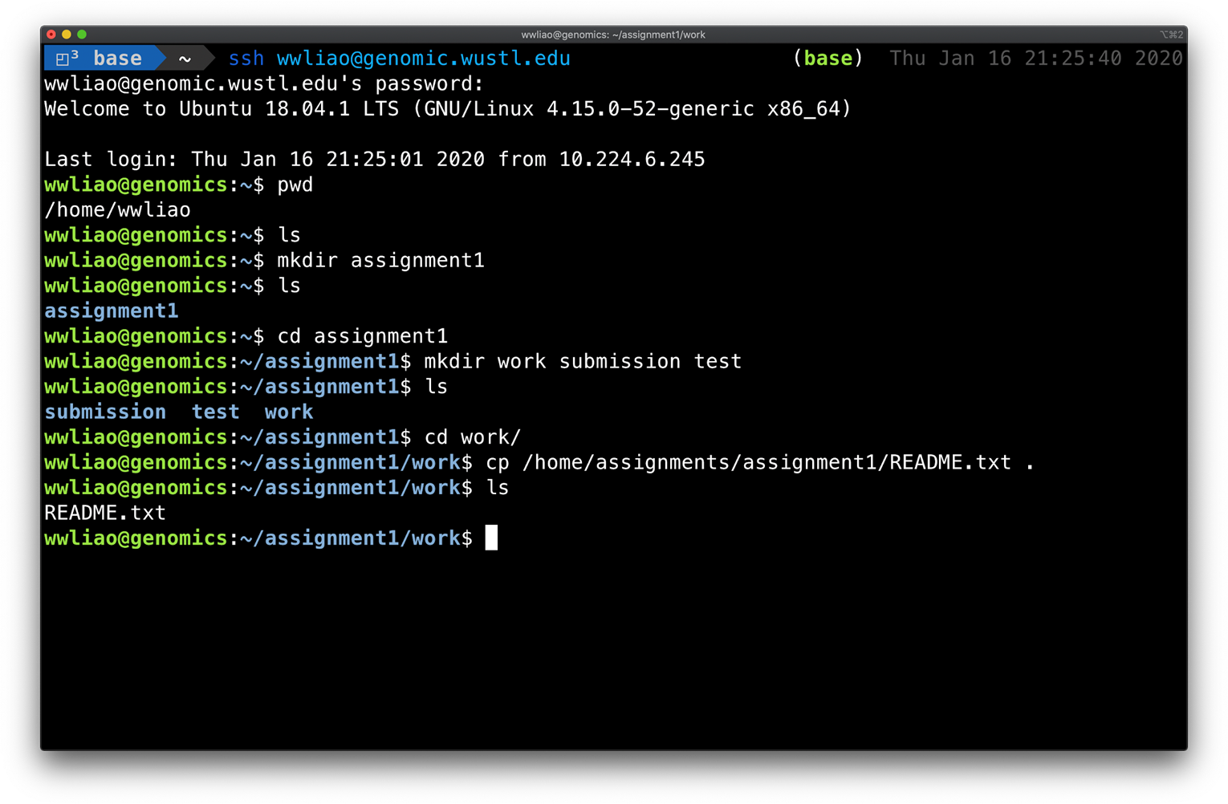

Slide 37
Renaming/moving things (mv)
To rename/move a file/directory
$ mv -i <original_filename> <new_filename>
where
<original_filename> = name of file/dir you want to rename
<new_filename> = name you want to rename it to
mv stands for move files/directories

Slide 38
Printing contents of files (cat)
To print a file
$ cat <filename>
where
<filename> = name of file you want to print
cat stands for concatenate file and print to the screen
Other useful commands for printing parts of files:
more
less
head
tail

Slide 39


Deleting Things (rm)
To delete a file
$ rm <file_to_delete>
where
<file_to_delete> = name of the file you want to delete
To delete a directory
$ rm –r -i <directory_to_delete>
where
TIP: Check that you’re going to delete the correct files by first testing with 'ls' and then committing to 'rm'
<directory_to_delete> = name of the directory you want to delete
rm stands for remove files/directories
IMPORTANT: there is no recycle bin/trash folder on Unix!!
Once you delete something, it is gone forever.
Be very careful when you use rm!!
41

Slide 40
Exercise: deleting things
Delete the test directory that you created in a previous exercise.

Slide 41
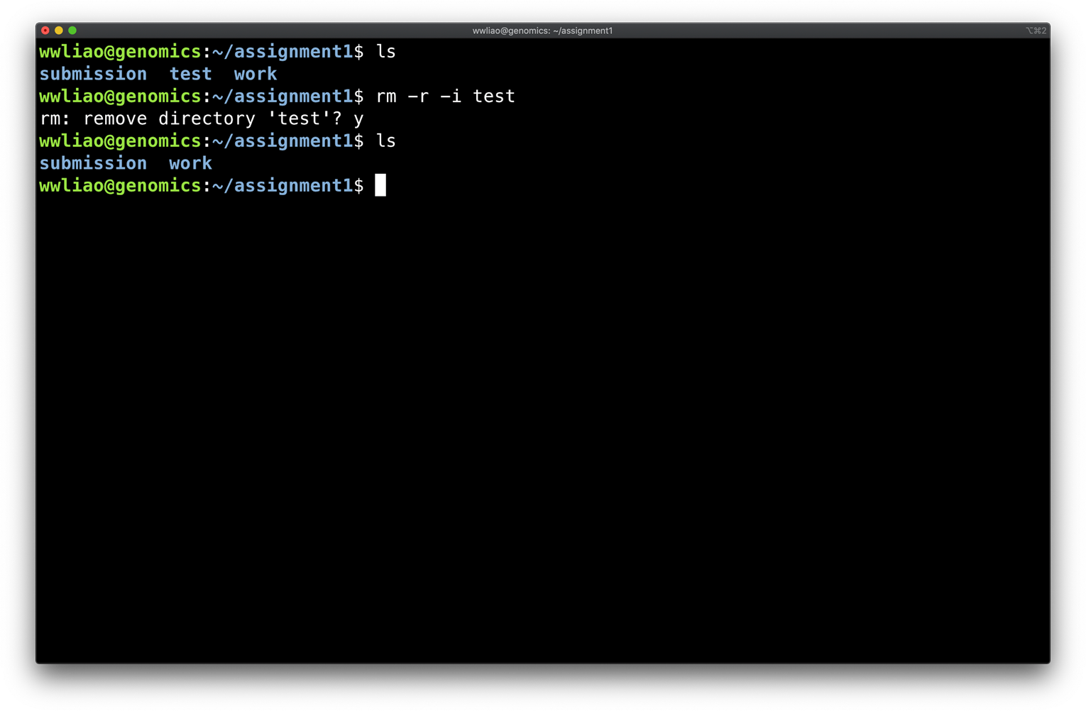

Slide 42

Saving output to files
Save the output to a file
$ <cmd> > <output_file>
where
<cmd> = command
<output_file> = name of output file
WARNING: this will overwrite the output file if it already exists!
Append the output to the end of a file
$ <cmd> >> <output_file>
There are 2 “>”

Slide 43
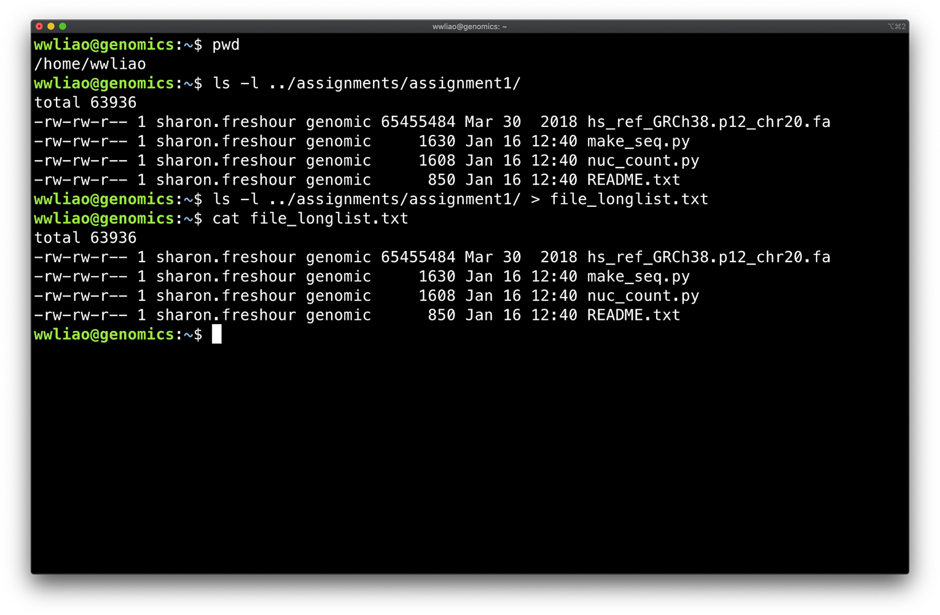

Slide 44
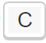
Learning more about a command (man)
To view a command’s documentation
$ man <cmd>
where
<cmd> = command
man stands for manual page
Use the and
↑
arrow keys to scroll through the manual page
↑
Type “q” to exit the manual page

Slide 45
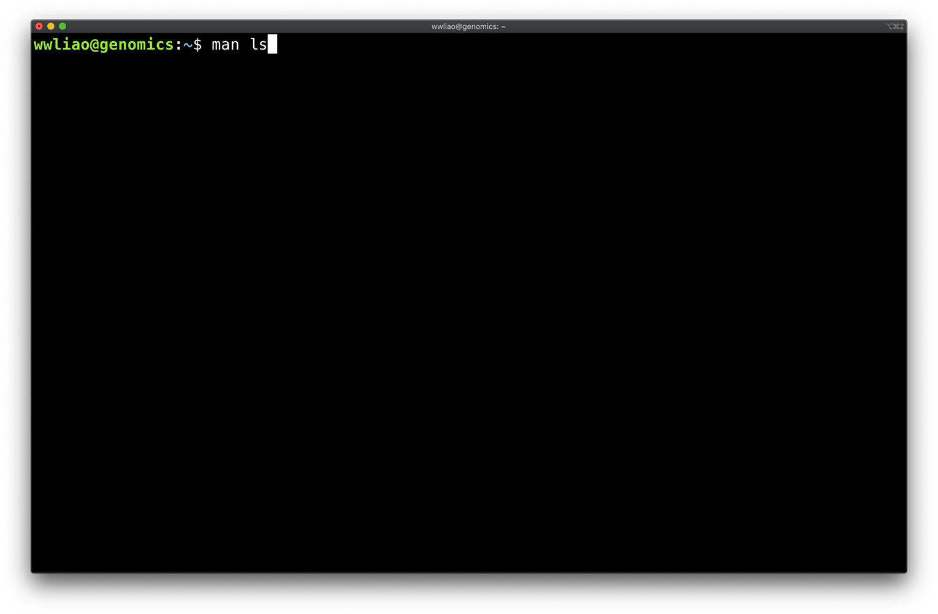

Slide 46
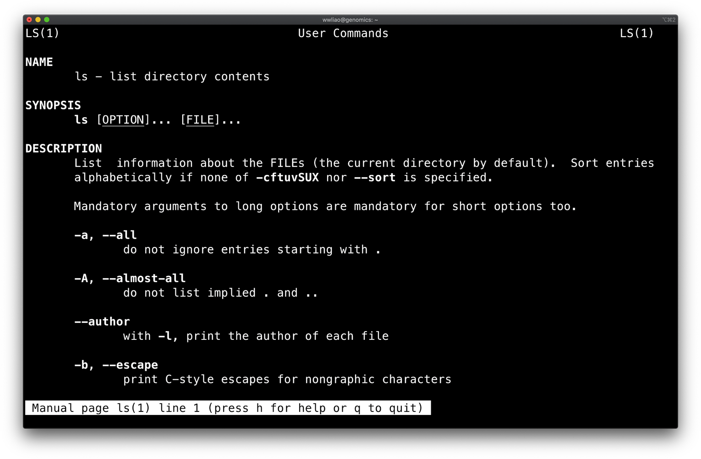

Slide 47
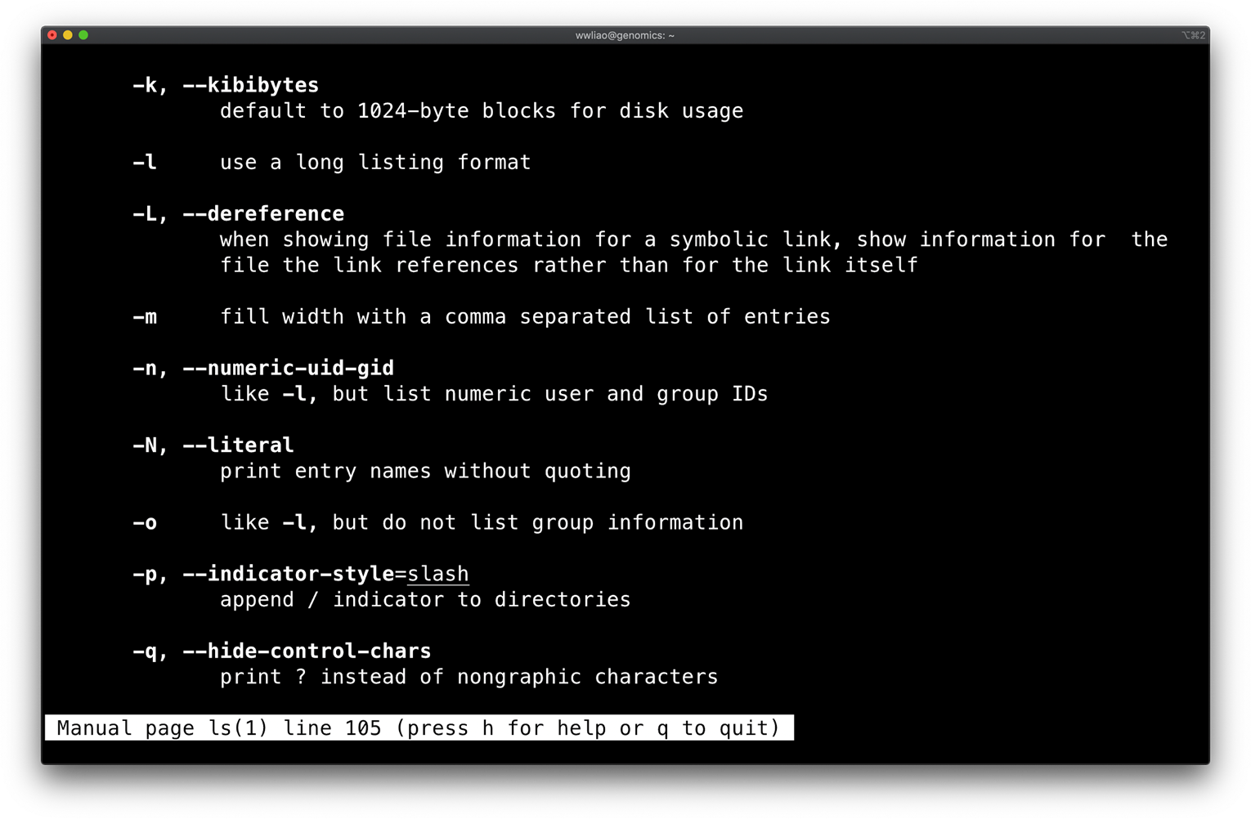

Slide 48

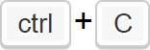
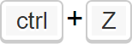
Getting yourself out of trouble
Abort a command
Temporarily stop a command
To bring the job back just run fg

Slide 49
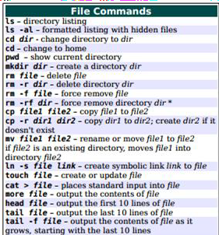
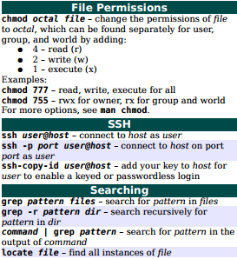
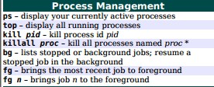
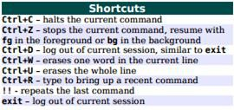
Unix commands cheatsheet--your new bestie
https://ubuntudanmark.dk/filer/fwunixref.pdf

Slide 50
Python in minutes*
*not really

Slide 51








Cross Platform
Programming Language
Created in 1991 by Guido van Rossum
Freely Usable Even for Commercial Use
There are 2 widely used versions of Python: Python2.7 and Python3.x
We’ll use Python3
Many help forums still refer to Python2, so make sure you’re
aware which version is being referenced
NOTE

Slide 52
How do I program in python?
Two Main Ways:
Normal mode
Write all your code in a file and save it with a .py extension
Execute it using python3 <file name> on the terminal.
Interactive mode
Start Interactive mode by typing python3 on the terminal and pressing enter/return.
Start writing your python code

Slide 53
Python Variables
The most basic component of any programming language are "things," also called variables
Variables can be integers, decimal numbers (floats), words and sentences (string), lists etc. etc.
Int : -5, 0, 1000000
Float : -2.0, 3.14159, 453.234
Boolean : True, False
String : "Hello world!", "K3WL", “AGCTGCTAGTAGCT”
List: [1, 2, 3, 4], ["Hello", "world!"], [1, "Hello", True, 0.2], [“A”, “T”, “C”, “G”
]

Slide 54
How do I create a variable and assign it a value?
x = 2
This creates a variable named x with value 2
2 = x is not a valid command; variable name needs to be on the left.
print(x)
This prints the value stored in x (2 in this case) on the terminal.
a = 3
b = 4
c = a + b print(c)
a = "Hello"
b = " "
c = "World" print(a+b+c)
Prints 7 on
the terminal
Prints Hello World on the terminal

Slide 55
Variables naming rules
Must start with a letter
Can contain letters, numbers, and underscores ← no spaces!
Python is case-sensitive: x ≠ X
Variable names should be descriptive and have reasonable length (more of a styling advice)
Use ALL CAPS for constants, e.g., PI
Do not use names already reserved for other purposes (min, max, int)
Want to learn more tips? Check out http://www.makinggoodsoftware.com/2009/05/04/71-tips-for-naming-variables/

Slide 56
Cool, what else can I do in python?
Conditionals
If a condition is TRUE do something, if it is FALSE do something else
if(boolean-expression-1): code-block-1
else:
code-block-2
CODE BLOCKS ARE INDENTED, USE 4 SPACES

Slide 57
Cool, what else can I do in python?
Conditionals
If a condition is TRUE do something, if it is FALSE do something else
x = 2
if(x == 2):
print(“x is 2”)
x = 3
if(x == 2):
print(“x is 2”)
Prints x is 2 on the terminal
Prints x is not 2 on the terminal
else:
print(“x is not 2”)
else:
print(“x is not 2”)

Slide 58
Conditionals with multiple conditions
Operator | Description | Example
< | Less than | >>> 2 < 3 True
<= e | Less than or equal to | >>> 2 <= 3 True
> | Greater than | >>> 2 > 3 False
>= | Greater than or equal to | >>> 2 >= 3 False
== | Equal to | >>> 2 == 3 False
!= | Not equal to | >>> 2 != 3 True
grade = 89.2
if grade >= 80:
print("A")
elif grade >= 65:
print("B")
Prints A on th terminal
elif grade >= 55:
print("C")
else:
print("E")

Slide 59

Loops

Slide 60
For loop
Useful for repeating
code!
Start with a list of items
for <counter> in
<collection_of_stuff>: code-block-1
Have we reached the last item?
Ye
s
Exit loop
No
Do stuff

Slide 61
For loop
genes = ["GATA4", "GFP", "FOXA1", "UNC-21"]
for i in genes:
print(i)
print("printed all genes")
Useful for repeating
code!
Start with a list of items
Have we reached the last item?
Ye
s
Exit loop
GATA4 GFP FOXA1 UNC-21
printed all genes
No
Do stuff

Slide 62
More examples
my_string = "Hello"
for i in my_string:
print(i)
my_number = 2500
for i in my_number:
print(i)
H
e l l
2
5
0
0
o
FURTHER READING: while loops in python http://learnpythonthehardway.org/book/ex33.html

Slide 63
Functions
input
Does some stuff
output
def <function name>(<input variables>): do some stuff
return <output>
def celsius_to_fahrenheit(celsius): fahrenheit = celsius * 1.8 + 32.0 return fahrenheit

Slide 64
But how do I use a function?
def celsius_to_fahrenheit(celsius): fahrenheit = celsius * 1.8 + 32.0 return fahrenheit
temp1 = celsius_to_fahrenheit(37) temp2 = celsius_to_fahrenheit(100) temp3 = celsius_to_fahrenheit(0)
#sets temp1 to 98.6 #sets temp2 to 212
#sets temp3 to 32

Slide 65
But how do I use a function?
def addition(num1, num2): num3 = num1 + num2 return num3
sum | = addition(4,5) | #sets | sum to 9
A = | 2
B = | 3
sum2 = addition(A, B) #sets sum2 to 5
sum3 = addition(5) #throws an error

Slide 66
Python functions: where can I learn more?
Python.org tutorial
User-defined functions:
https://docs.python.org/3/tutorial/controlflow.html#defining-functions
Python.org documentation
Built-in functions: https://docs.python.org/3/library/functions.html
68

Slide 67
Commenting your code
Why is this concept useful?
Makes it easier for--you, your future self, TAs ☺, anyone unfamiliar with
your code--to understand what your script is doing
Comments are human readable text. They are ignored by Python.
Add comments for
The how
What the script does
How to run the script
What a function does
What a block of code does
The why
Biological relevance
Rationale for design and methods
Alternatives
TREAT YOUR CODE LIKE A LAB NOTEBOOK

Slide 68
Commenting rule of thumb
Always code [and comment] as if the guy who ends up maintaining your code will be a violent psychopath who knows where you live. Code for readability.
-- John Woods
Points will be deducted if you do not comment your code
If you use code from a resource, e.g., a website, cite it

Slide 69
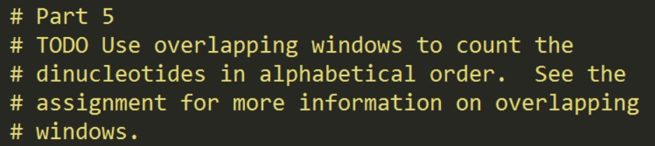
Comment syntax
Syntax | Example
Block comment
# <your_comment> # <your_comment>
In-line comment
<code> # <your_comment>

Slide 70
Python modules
A module is file containing Python definitions and statements for a particular purpose, e.g.,
Generating random numbers
Plotting
Modules must be imported at the beginning of the script
This loads the variables and functions from the module into your script, e.g.,
import sys import random
To access a module’s features, type <module>.<feature>, e.g.,
sys.exit()

Slide 71
Random module
Contains functions for generating random numbers for various distributions
TIP: will be useful for assignment 1
Function | Description
random.choice | Return a random element from a list
random.randint | Return a random interger in a given range
random.random | Return a random float in the range [0, 1)
Random.seed | Initialize the (pseudo) random number generator
https://docs.python.org/3.4/library/random.html

Slide 72
Example
import random
numberList = [111,222,333,444,555]
#assigns a values from numberList to x at random
x = random.choice(numberList)

Slide 73
Strings
String is a sequence of characters, like "Python is cool"
Each character has an index
Accessing a character: string[index] x = "Python is cool" print(x[10])
Accessing a substring via slicing: string[start:finish] print(x[2:5])
Prints tho and not thon
P | y | t | h | o | n |  | i | s |  | c | o | o | l
0 | 1 | 2 | 3 | 4 | 5 | 6 | 7 | 8 | 9 | 10 | 11 | 12 | 13

Slide 74
More string stuff
>>> x = "Python is cool"
>>> "cool" in x
>>> len(x)
>>> x + "?"
>>> x.upper()
# membership
# length of string
x # concatenation # to upper case
>>> x.replace("c", "k") # replace characters in a string

Slide 75
Lists
If a string is a sequence of characters, then
a list is a sequence of items!
List is usually enclosed by square brackets [ ]
As opposed to strings where the object is fixed (= immutable), we are free to modify lists (that is, lists are mutable).
x = [1, 2, 3, 4]
x[0] = 4
x.append(5)
print(x) # [4, 2, 3, 4, 5]

Slide 76
More lists stuff
>>> x = [ "Python", "is", "cool" ]
>>> x.sort()
>>> x[0:2]
>>> len(x)
>>> x + ["!"]
>>> x[2] = "hot"
# sort elements in x # slicing
# length of string x # concatenation
# replace element at index 2 with
>>> x.remove("Pyth"o_{h}n_{o}"_{t"}) # remove the first occurrence of "Python"
>>> x.pop(0) # remove the element at index 0

Slide 77
Lists: where can I learn more?
Python.org tutorial: https://docs.python.org/3.4/tutorial/datastructures.html#more-on- lists
Python.org documentation: https://docs.python.org/3.4/library/stdtypes.html#list

Slide 78
Command-line arguments
Why are they useful?
Passing command-line arguments to a Python script allows a script to be customized
Example
make_nuc.py can create a random sequence of any length
If the length wasn’t a command-line argument, the length would be hard- coded
To make a 10bp sequence, we would have to 1) edit the script, 2) save the script, and 3) run the script.
To make a 100bp sequence, we’d have to 1) edit the script, 2) save the script, and 3) run
the script.
This is tedious & error-prone
Remember: be a lazy programmer!

Slide 79
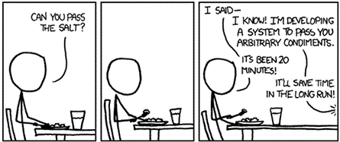

Slide 80

Command-line arguments
Python stores the command-line arguments as a list called sys.argv
sys.argv[0] # script name
sys.argv[1] # 1st command-line argument
…
IMPORTANT: arguments are passed as strings!
If the argument is not a string, convert it, e.g., int(), float()
sys.argv is a list of variables
The values of the variables, are not “plugged in” until the script is run

Slide 81
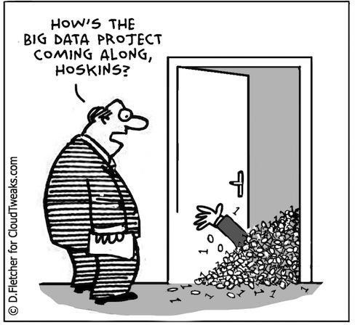
Reading (and writing) to files in Python
Why is this concept useful?
Often your data is much larger than just a few numbers:
Billions of base pairs
Millions of sequencing reads
Thousands of genes
It’s may not feasible to write all of this data
in your Python script
Memory
Maintenance
How do we solve this problem?

Slide 82
Reading (and writing) to files in Python
Input file
The solution:
Store the data in a separate file
Then, in your Python script
Read in the data (line by line)
Analyze the data
Write the results to a new output file or print them to the terminal
When the results are written to a file, other scripts can read in the results file to do more analysis
Python script 1
Output file 1
Python script 2
Output file 2

Slide 83
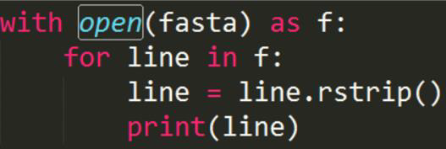
Reading a file syntax
Syntax
Example
with open(<file>) as <file_handle>:
for <current_line> in open(<file>) , ‘r’):
<current_line> = <current_line>.rstrip() # Do something
Output
>chr1 ACGTTGAT ACGTA

Slide 84
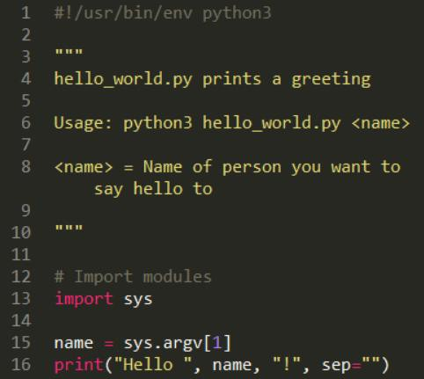
The anatomy of a (simple) script
The first line should always be
#!/usr/bin/env python3
This special line is called a shebang
The shebang tells the computer how to run the script
It is NOT a comment

Slide 85
The anatomy of a (simple) script
This is a special type of comment called a doc string, or documentation string
Doc strings are used to explain 1) what script does and 2) how to run it
ALWAYS include a doc string
Doc strings are enclosed in triple
quotes, “““

Slide 86
The anatomy of a (simple) script
This is a comment
Comments help the reader better understand the code
Always comment your code!

Slide 87
The anatomy of a (simple) script
This is an import statement
An import statement loads variables and functions from an external Python module
The sys module contains system-
specific parameters and functions
89

Slide 88
The anatomy of a (simple) script
This grabs the command line argument using sys.argv and stores it in a variable called name
90

Slide 89
The anatomy of a (simple) script
This prints a statement to the terminal using the print function
The first list of arguments are the
items to print
The argument sep=“” says do not print a delimiter (i.e., a separator) between the items
The default separator is a space.
91

Slide 90
Python resources
Documentation
https://docs.python.org/3/
Tutorials
https://www.learnpython.org/
https://www.w3schools.com/python/
https://www.codecademy.com/learn/learn-python-3

Slide 91
Assignment 1

Slide 92
How to complete & “turn in” assignments
classDir=/storage1/fs1/workshops/Active/BIO5488/SP2026.L41.BIOL.5488.01/Assignments
“Submissions” and “Users” subdirectories
Users= scratch work
Submissions = final version
The TAs will only grade content that is in your submission directory
Copy the starter scripts and README to your work directory
cp ${classDir}/A**/Assignment_Data/. ${classDir}/A**/Users/${Username}/
Copy the final version of the files to your submission directory
cp ${classDir}/A**/Users/${Username}/. ${classDir}/A**/Submissions/*yourUser*
Do not edit your submission files after 11:59 pm on the due date (always Friday)

Slide 93
README files
README.txt file contains information on how to run your code and answers to any of the
questions in the assignment
A template will be provided for each assignment
Copy the template to your work folder
Replace the text in {} with your answers
Leave all other lines alone ☺
README.txt template
Completed README.txt
Question 1:
{nuc_count.py nucleotide count output}
-
Comments:
{Things that went wrong or you can not figure out}
-
Question 1:
A: 10
C: 15
G: 20
T: 12
-
Comments:
The wording for part 2 was confusing.
-
95

Slide 94
Usage statements in README and scripts
Purpose
Tells a user (you, TA, anyone unfamiliar with the script) how to run the script
Documents how you created your results
In your README
Write out exactly how you ran the script:
python3 foo.py 10 bar
In your scripts
Write out how to run the script in general with placeholders for command-line arguments
python3 foo.py <#_of_genes> <gene_of_interest>
TIP: copy and paste your commands into your README
TIP: use the command history to view previous commands

Slide 95
Assignment 1 Set Up
Create assignment1 directory
Create work, submission subdirectories
Copy assignment material (README, starter scripts) to work directory
Download human chromosome 20 with wget or FTP

Slide 96


Fasta file format
Standard text-based file format used to define sequences
.fa, .fasta, .fna, …, extensions
Each sequence is defined by multiple lines
Line 1: Description of sequence. Starts with “>”
Lines 2-N: Sequence
A fasta can contain ≥ 1 sequence
Example fasta file
1
2
3
4
5
>chr22 ACGGTACGTACCGTAGATNAGTAN
>chr23
ACCGATGTGTGTAGGTACGTNACG TAGTGATGTAT

Slide 97
Assignment 1 To-Do’s
Given a starter script (nuc_count.py) that counts the total number of A, C, G, T nucleotides
Modify the script to calculate the nucleotide frequencies
Modify the script to calculate the dinucleotide frequencies
Complete a starter script (make_seq.py) to generate a random sequence given nucleotide frequencies
Use make_seq.py to generate random sequence with the same
nucleotide frequencies as chr20
Compare the chr20 di/nucleotide frequencies (observed) with the random model (expected)
Answer conceptual questions in README

Slide 98
Requirements
Due next Friday (1/27) at 11:59 PM
Your submission folder should contain:
A Python script to count nucleotides (nuc_count.py)
A Python script to make a random sequence file (make_seq.py)
An output file with a random sequence
(random_seq_1M.txt)
A README.txt file with instructions on how to run your programs and answers to the questions.
Remember to comment your script!

Slide 99

